Slide 1

Building Trust in Modern Computing Platforms
Aritra Dhar
ETH Zurich

Slide 2

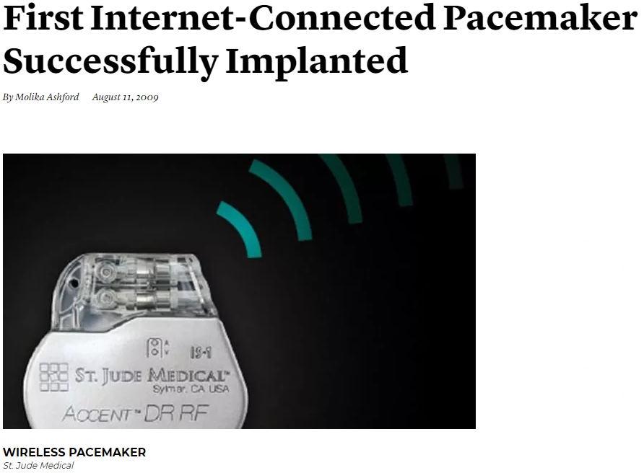


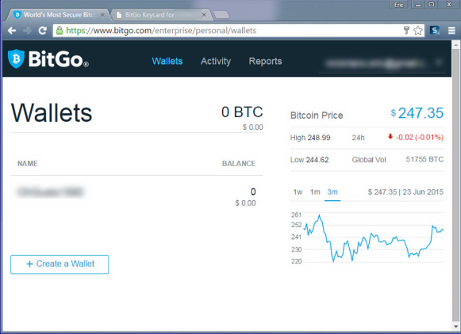
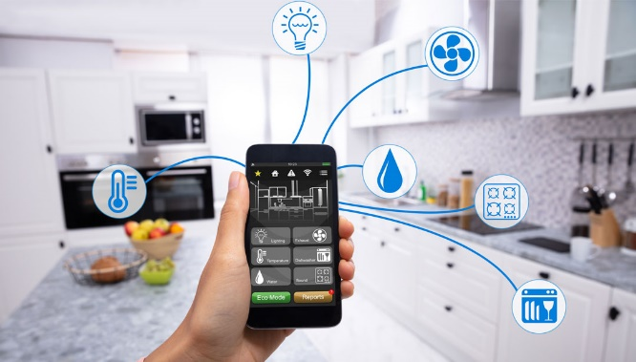
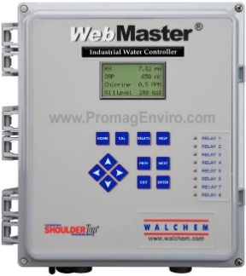
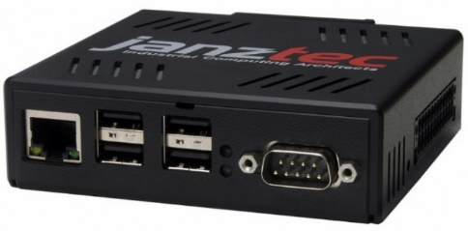
Remote safety/security-critical systems
Images are from janztec, wired, getty, controlbyweb
Notes:
First I will motivate you with some relevant examples that involves remote safety and security critical systems. Automation in industrial sector is getting more prevalent today and more and more of our critical infrastructure such a the electricity grid, gas pipelines, are monitored and actuated by these PLC or programmable logic controller. Compared to traditional PLCS, these are often web-enabled, i.e., they are networked attached and provide a web UI. The operators can remotely connect to the devices, monitor and actuate the equipments.
Other critical systems such as medical implants such as a pacemaker are becoming more and more smart so that a medical technicians can connect to them and monitor vitals or change some operational parameters. Smart homes are also another example where IoT devices report the current state of the home and user can operate them remotely. They also provide web or mobile enabled UI. Other, more traditional use cases could be financial transaction. And more and more people, specially during pandemic are opting for these web services.

Slide 3

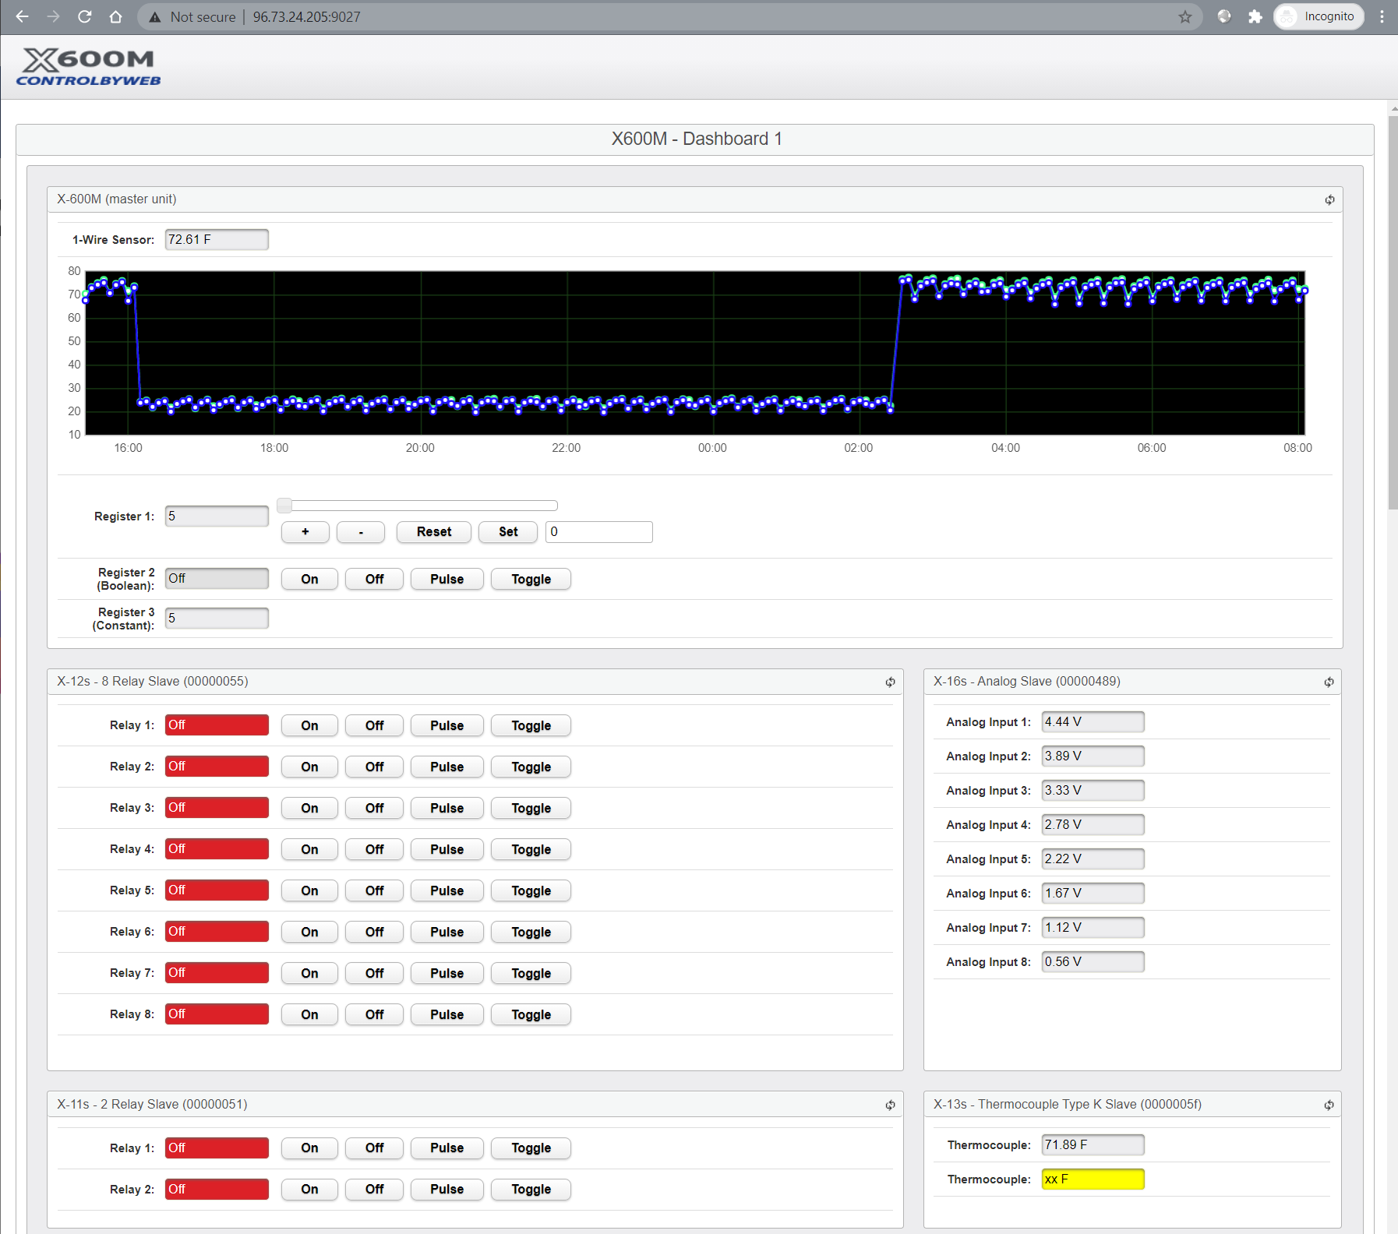
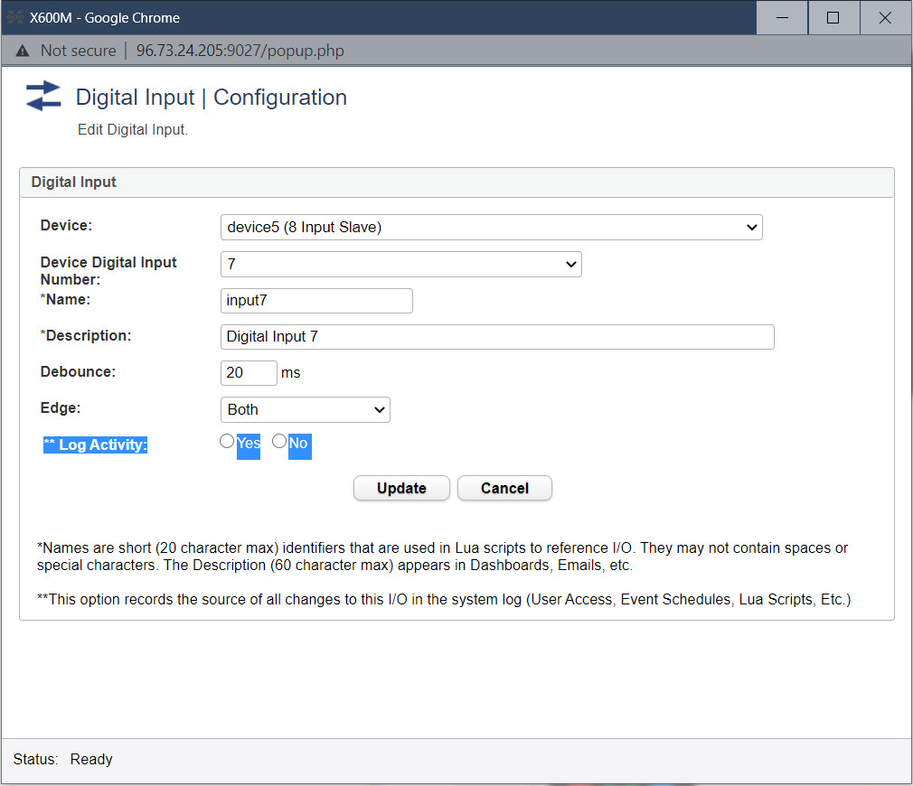
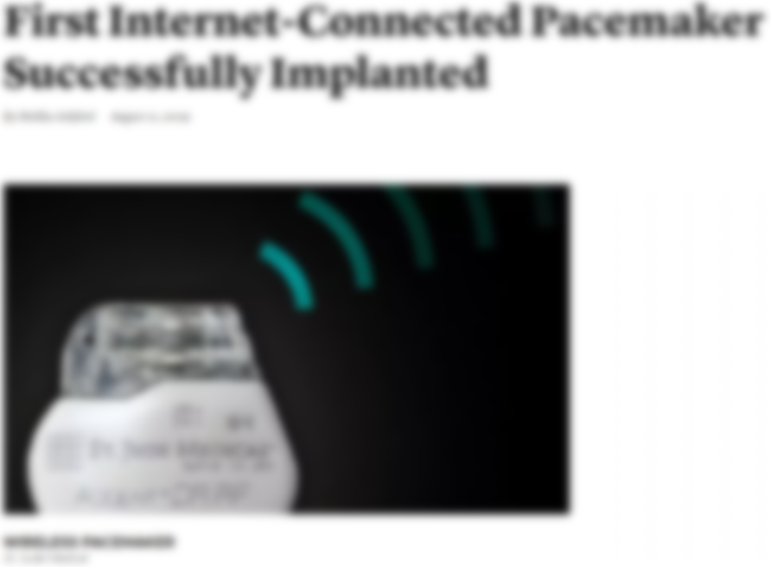



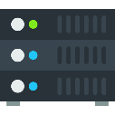

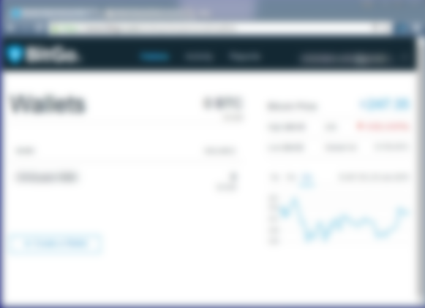


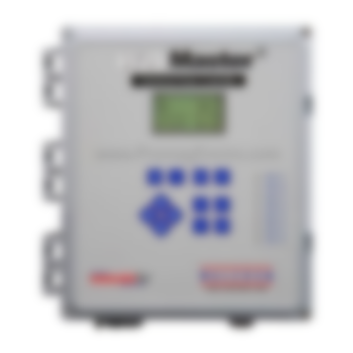

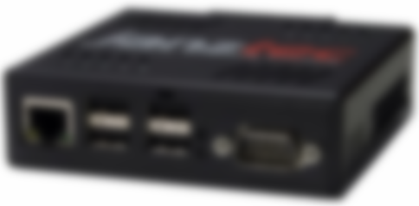

Remote safety/security-critical systems
Images are from janztec, wired, getty, controlbyweb

Slide 4







Large TCB $→$ Large Attack Surface
25.16M
20.92M
2M
36.68M
600K
CPU microcode
Device firmware
Device drivers

Slide 5
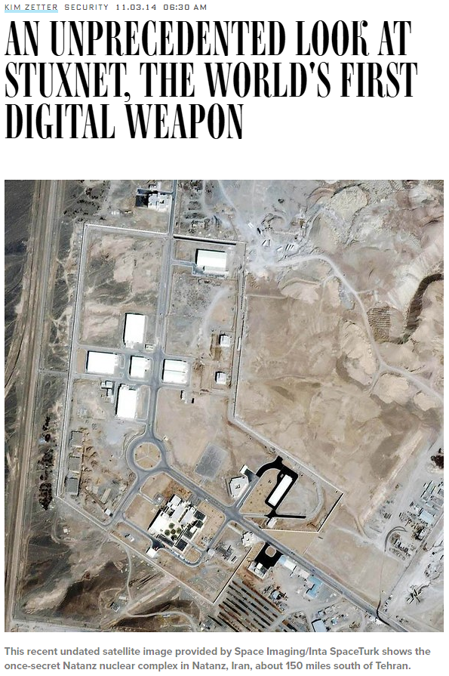
Attacks
Images are from wired, csmonitor, heimdalsecurity

Slide 6
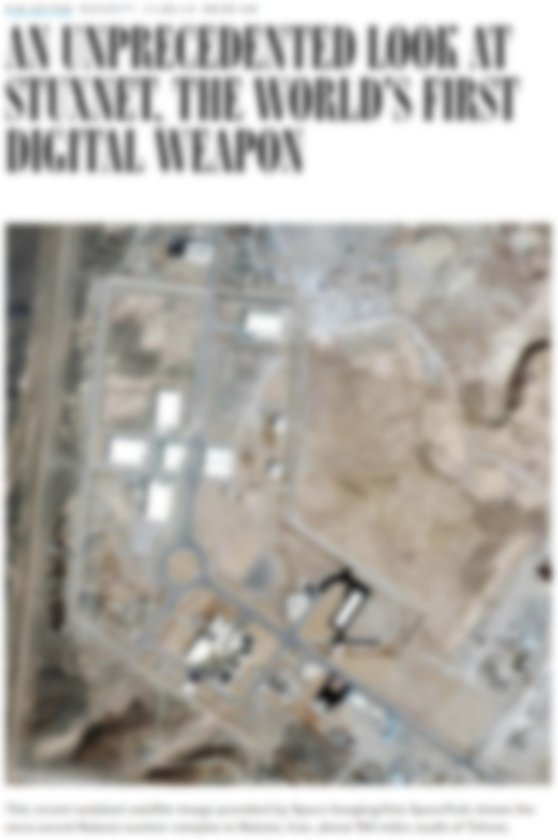
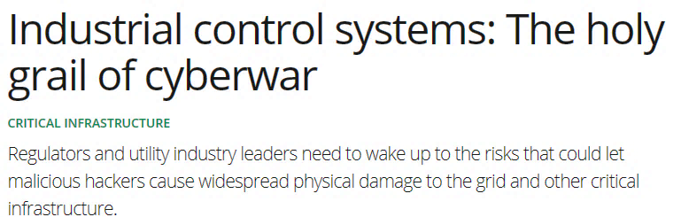
Attacks
Images are from wired, csmonitor, heimdalsecurity

Slide 7
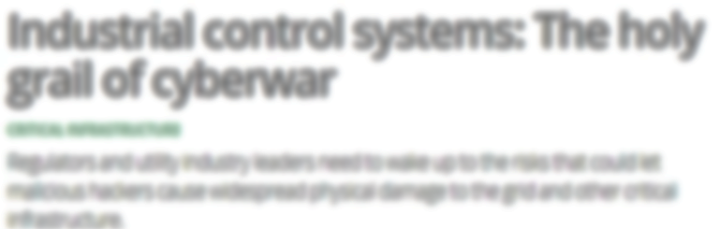
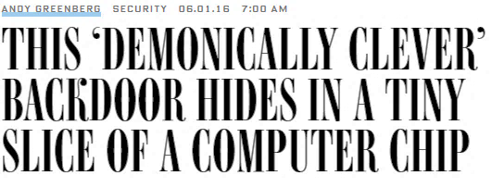
Attacks
Images are from wired, csmonitor, heimdalsecurity

Slide 8
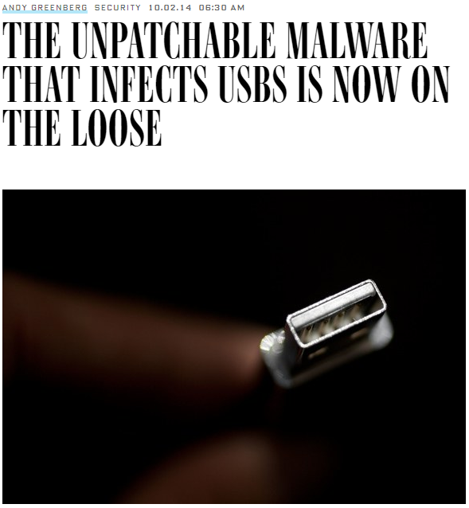
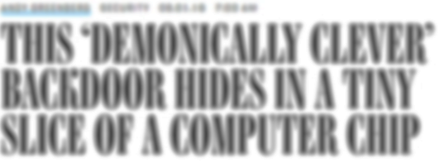
Attacks
Images are from wired, csmonitor, heimdalsecurity

Slide 9
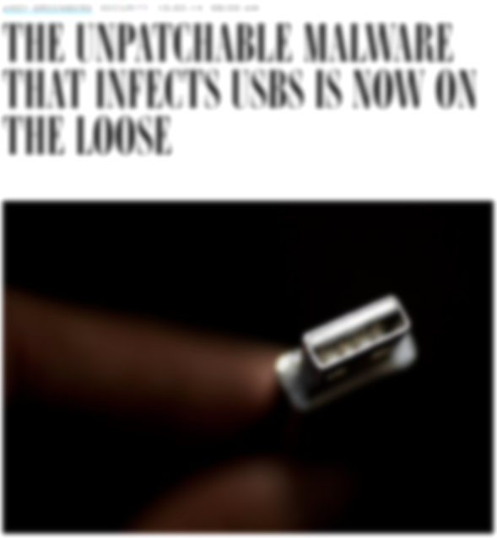
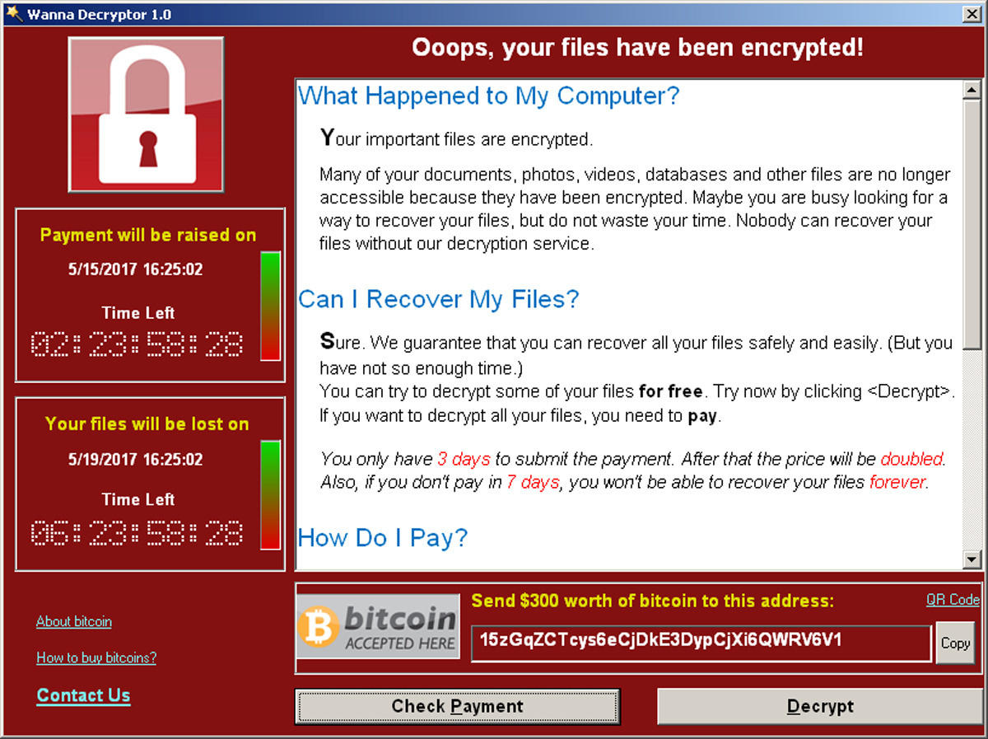
Attacks
Images are from wired, csmonitor, heimdalsecurity

Slide 10




Concrete Attack Scenario
Remote device
Heart beat
75
65
Insulin (U)
177
Basal rate (U/Hr)
0.025
Low limit (mg/dL)
60
High limit (mg/dL)
105
Program
Cancel
Aritra Dhar

Slide 11






Remote Trusted path for IO
User
IO devices
Host
Remote System

Slide 12






Trusted Execution Environment (TEE)
TCB
App
App
App
App
App
Enclave
Operating System
Operating System
Dev
DRAM
CPU
Dev
DRAM
CPU
TCB
TCB
Traditional platforms
Intel SGX
OS still manages devices
Static HW TCB

Slide 13

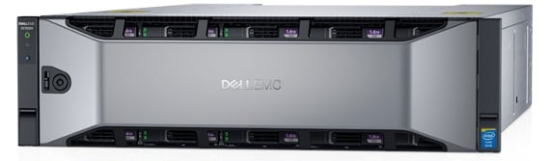
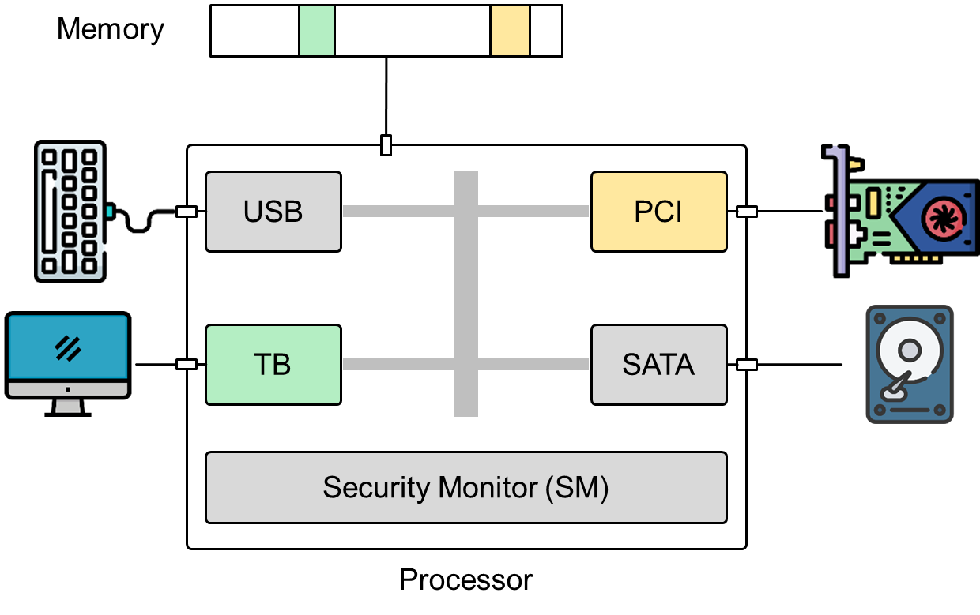
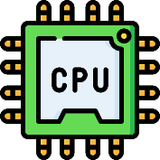
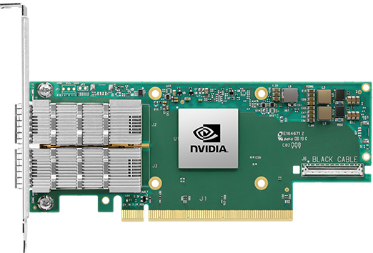
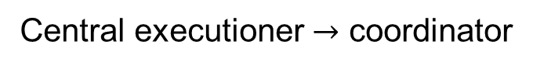
Disaggregated computing
Traditional CPU-centric model
Central executioner $→$ coordinator
Images are from nVidia, Dell, Mellanox official websites

Slide 14






My Contribution
IntegriKey (2017, eprint: 2017/1245)
ProtectION (NDSS 2020)
IntegriScreen (2018, arXiv:2011.13979)
Remote system
Remote trusted path application

Slide 15
My Contribution
IntegriKey (2017, eprint: 2017/1245)
ProtectION (NDSS 2020)
IntegriScreen (2018, arXiv:2011.13979)
Remote system
Remote trusted path application
ProximiTEE (CODASPY 2020)

Slide 16

My Contribution
IntegriKey (2017, eprint: 2017/1245)
ProtectION (NDSS 2020)
IntegriScreen (2018, arXiv:2011.13979)
Remote system
Remote trusted path application
Dedicated Security Chips in the Age of Secure Enclaves (IEEE S&P magazine 2020)
ProximiTEE (CODASPY 2020)

Slide 17



My Contribution
PIE (2020, arXiv:2010.10416)
IntegriKey (2017, eprint: 2017/1245)
ProtectION (NDSS 2020)
IntegriScreen (2018, arXiv:2011.13979)
Remote system
Remote trusted path application
Dedicated Security Chips in the Age of Secure Enclaves (IEEE S&P magazine 2020)
ProximiTEE (CODASPY 2020)

Slide 18
My Contribution
PIE (2020, arXiv:2010.10416)
IntegriKey (2017, eprint: 2017/1245)
ProtectION (NDSS 2020)
IntegriScreen (2018, arXiv:2011.13979)
Remote system
Remote trusted path application
Dedicated Security Chips in the Age of Secure Enclaves (IEEE S&P magazine 2020)
ProximiTEE (CODASPY 2020)

Slide 19
Today’s Talk
PIE (2020, arXiv:2010.10416)
IntegriKey (2017, eprint: 2017/1245)
ProtectION (NDSS 2020)
IntegriScreen (2018, arXiv:2011.13979)
Remote system
Remote trusted path application
Dedicated Security Chips in the Age of Secure Enclaves (IEEE S&P magazine 2020)
ProximiTEE (CODASPY 2020)

Slide 20
ProtectIOn setting
Remote trusted path application
Remote system

Slide 21







Solution 1: Transaction Confirmation Device
Remote device
Heart beat
75
Insulin (U)
177
Basal rate (U/Hr)
0.025
Low limit (mg/dL)
60
Android Protected Confirmation
You are going to program
Heart beat 75
Insulin 177U
Basal rate 0.025 U/Hr
Low level 60 mg/dL
High level 105 mg/dL
And more ……
High limit (mg/dL)
105
Program
Cancel

Slide 22



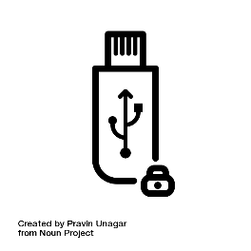
Solution 2: Input Signing
Remote device
Heart beat
75
Insulin (U)
177
Heart beat 75
Insulin 177U
Basal rate 0.025 U/Hr
Low level 60 mg/dL
High level 105 mg/dL
Basal rate (U/Hr)
0.025
Low limit (mg/dL)
60
Trusted embedded device
High limit (mg/dL)
105
Program
Cancel

Slide 23



Display manipulation attack
177
177
Insulin
17
7
1777
Insulin
177
User sees 177
Device records 1777
Host sends 1777

Slide 24
Observation 1
The lack of output integrity – the render of user inputs on the screen – compromises input integrity.

Slide 25

Solution 3: Overlay
Remote device
Remote device
Heart beat
Heart beat
75
Insulin (U)
Insulin (U)
177
Basal rate (U/Hr)
Basal rate (U/Hr)
0.025
Low limit (mg/dL)
Low limit (mg/dL)
60
High limit (mg/dL)
High limit (mg/dL)
105
Program
Cancel
Program
Cancel

Slide 26
Attack on Overlay: Output Manipulation
Remote device
Remote device
Heart beat
Insulin (U)
Insulin (U)
Heart rate
Basal rate (U/Hr)
Basal rate (U/Hr)
Low limit (mg/dL)
Low limit (mg/cc)
High limit (mg/dL)
High limit (mg/cc)
Program
Cancel
Program
Cancel

Slide 27

Overlay: Output Manipulation
Remote device
Remote device
Heart rate
75
Insulin (U)
177
Insulin (U)
177
Heart rate
75
Basal rate (U/Hr)
0.025
Basal rate (U/Hr)
0.025
Low limit (mg/dL)
60
Low limit (mg/cc)
6000
High limit (mg/dL)
105
High limit (mg/cc)
10500
Program
Cancel
Program
Cancel

Slide 28
Observation 2
If the protected output is provided out-of-context,
users are more likely not to verify it.
Therefore input integrity can be violated.

Slide 29
Overlay: Early Form Submission Attack
Remote device
Heart beat
75
Textbox in focus
Insulin (U)
17
Basal rate (U/Hr)
0.025
Fidelius
Trusted overlay from FPGA
Low limit (mg/dL)
60
High limit (mg/dL)
105
OS triggers click
Program
Cancel

Slide 30
Observation 3
If not all the modalities of inputs are secured simultaneously,
none of them can be fully secured.

Slide 31






Requirements
The lack of output integrity – the render of user inputs on the screen – compromises input integrity.
Inter-dependency between Input and output

Slide 32
Requirements
If not all the modalities of inputs are secured simultaneously, none of them can be fully secured.
All modalities of input

Slide 33
Requirements
If the protected output is provided out-of-context, users are more likely not to verify it. Therefore input integrity can be violated.
Low cognitive load

Slide 34
Requirements
Low TCB and easy deploy

Slide 35
Requirements

Slide 36








ProtectIOn
Low TCB + fast deployment
Input modalities
IOHub

Slide 37

IO Integrity – Server-side Annotation
Remote device
Heart beat
<label for="insulin" secure="true">Insulin (U)</label> <input type="text" id="insulin" name="insulin" secure="true">
Insulin (U)
Basal rate (U/Hr)
Simultaneous IO
Low limit (mg/dL)
High limit (mg/dL)
Program
Cancel
ProtectIOn JS
<form action="/some_action", signature = "0x45AB…", id = "0x0ab..">

Slide 38


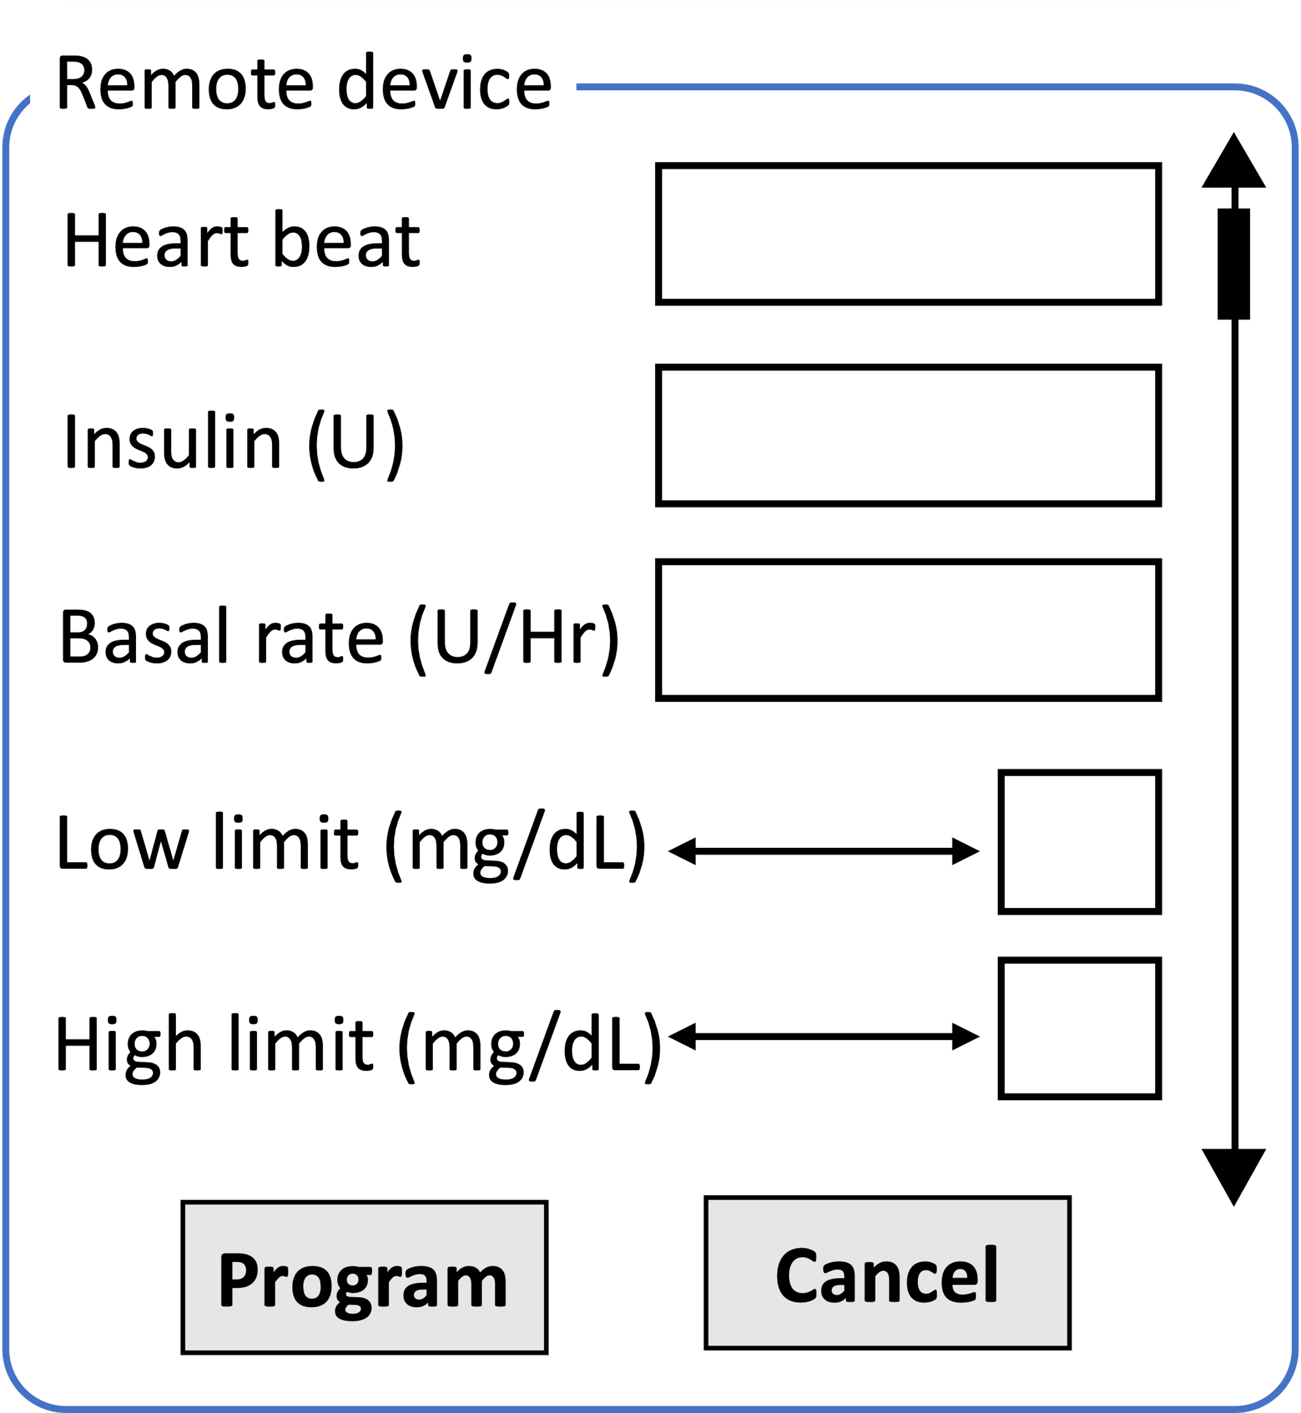
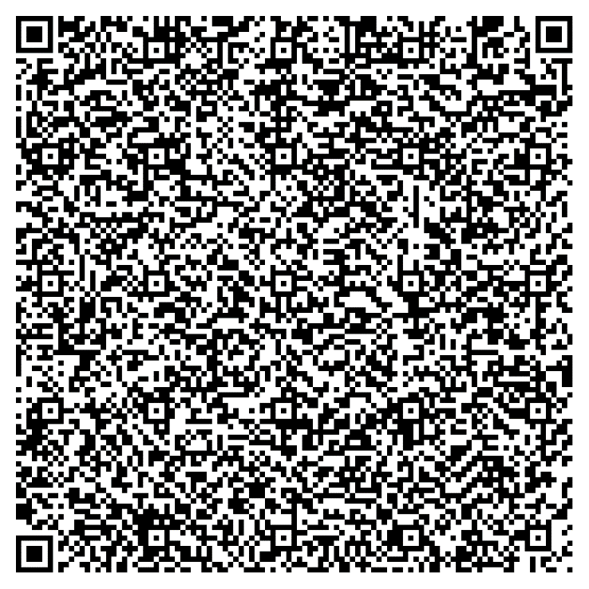
IO Integrity – HTML $→$ Specification
{
"formId": "form1",
"formName": "configure device",
"domain": "secure_site.io",
"size": "400*400",
"SAS": "5:LB",
"ui": [{
"id": "Insulin", "type": "textbox",
"label": “Insulin (U)",
"text":"",
"RE":(0-9)+},
{"id": "Heart rate",
…},
{"id":"b1",
"type": "button",
"label": "Program",
"trigger": "true"},
…],
"signature": "0x45AB...",
"id": "0x0ab.."}
<form action="/some_action", signature = "0x45AB…", id = "0x0ab..">
<label for="insulin" secure="true">Insulin
(U)</label> <input type="text" id="insulin"
name="insulin" secure="true"> …
</form>
ProtectIOn JS
Simultaneous IO
form1.bmp

Slide 39
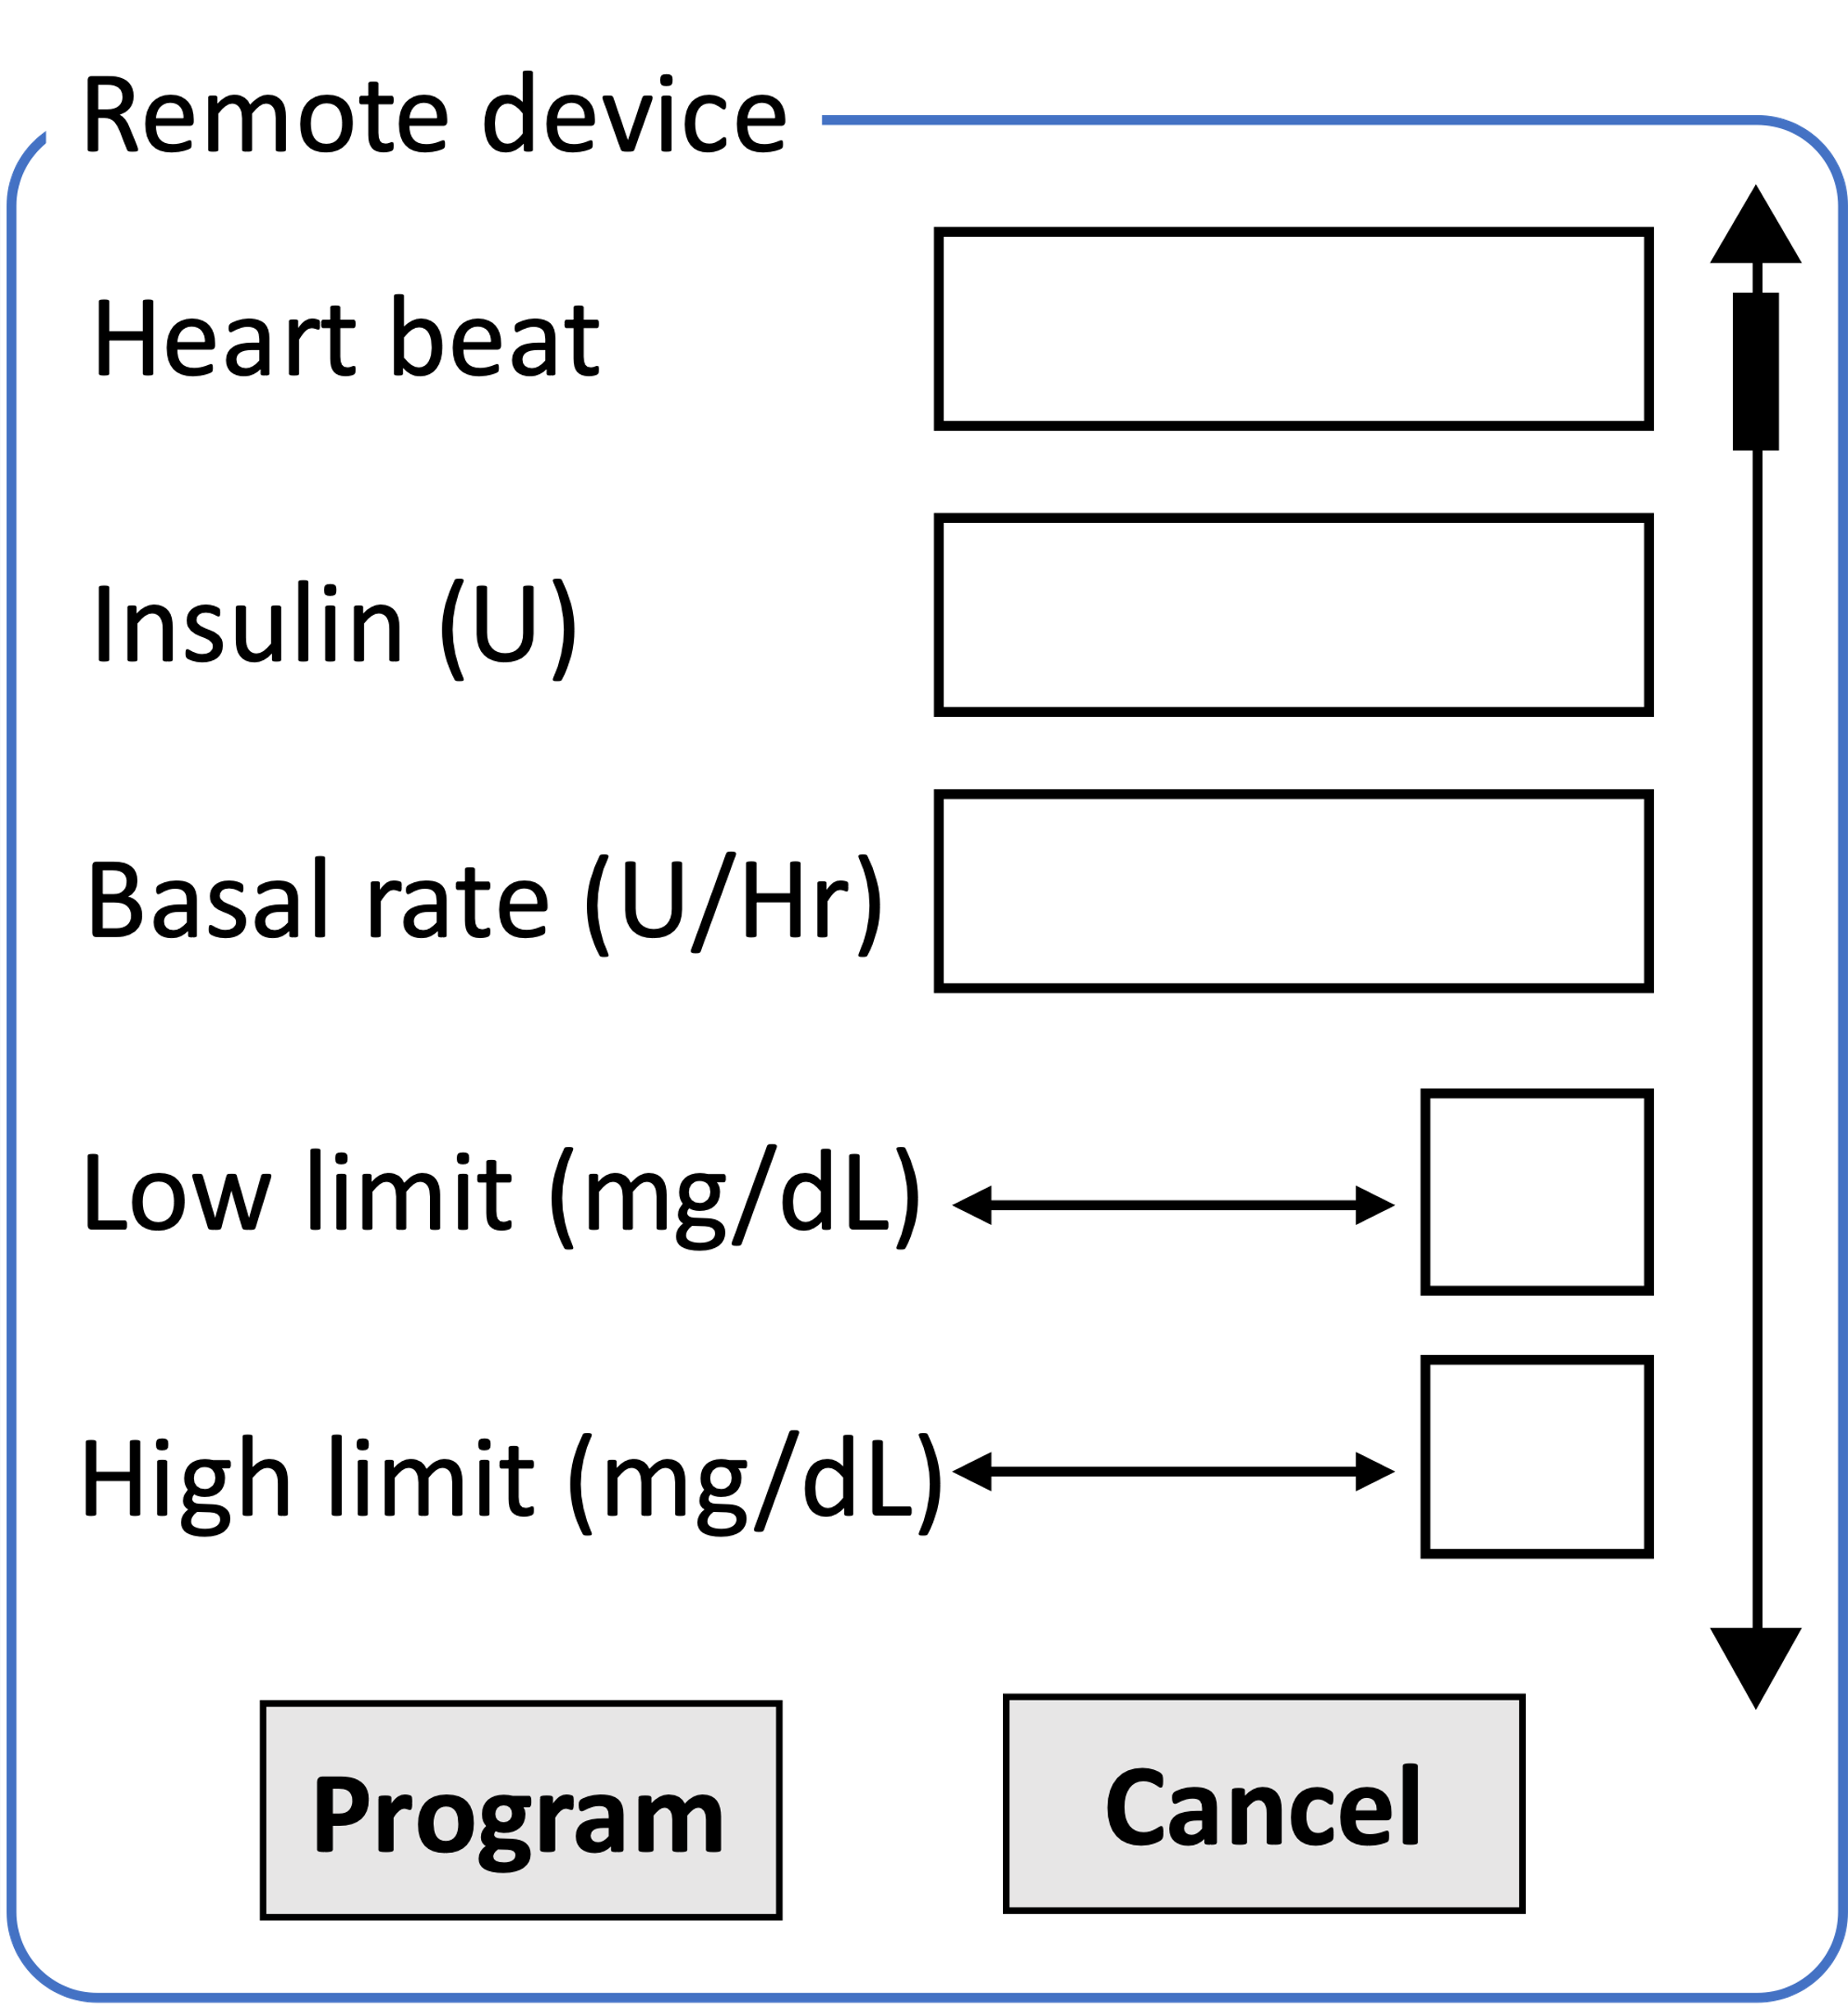
IO Integrity – UI $→$ QR Code
…
<form action="/some_action", signature = "0x45AB…", id = "0x0ab..">
<label for="insulin" secure="true">
Insulin(U)</label> <input type="text" id="insulin"
name="insulin" secure="true">
…
</form>
…
…
<img src=“form1.bmp”>
…
Simultaneous IO
ProtectIOn JS

Slide 40

IO Integrity – QR Code $→$ Overlay Generation
{
"formId": "form1",
"formName": "configure device",
"domain": "secure_site.io",
"size": "400*400",
"SAS": "5:LB",
"ui": [{
"id": "Insulin", "type": "textbox",
"label": “Insulin (U)",
"text":"",
"RE":(0-9)+},
{"id": "Heart rate",
…},
{"id":"b1",
"type": "button",
"label": "Program",
"trigger": "true"},
…],
"signature": "0x45AB...",
"id": "0x0ab.."}
Simultaneous IO

Slide 41
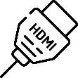


IO Integrity – QR Code $→$ Overlay Generation
Remote device
Verified UI from secure_site.io
Insulin (U)
Heart rate
Simultaneous IO
Basal rate (U/Hr)
Low limit (mg/cc)
High limit (mg/cc)
Program
Cancel

Slide 42


IO Integrity – Input
Remote device
Verified UI from secure_site.io
Insulin (U)
75
Heart rate
177
Simultaneous IO
Basal rate (U/Hr)
0.025
Low limit (mg/cc)
60
High limit (mg/cc)
105
Program
Cancel
ProtectIOn JS

Slide 43
User Attention for Integrity
Untrusted UI
Trusted UI
Put 1 in front of all inputs

Slide 44
User Attention for Integrity
Untrusted UI
Trusted UI
Put 1 in front of all inputs

Slide 45
User Attention for Integrity
Untrusted UI
Trusted UI
Put 1 in front of all inputs

Slide 46
Grabbing User Attention
Output Integrity: Low cognitive load
Several existing mechanisms
Low cognitive load
Put 1 in front of all inputs

Slide 47
Grabbing User Attention
Output Integrity: Low cognitive load
Several existing mechanisms
Lightbox
Low cognitive load
Put 1 in front of all inputs

Slide 48
Grabbing User Attention
Output Integrity: Low cognitive load
Several existing mechanisms
Lightbox
Highlight
Low cognitive load
Put 1 in front of all inputs

Slide 49
Grabbing User Attention
Output Integrity: Low cognitive load
Several existing mechanisms
Lightbox
Highlight
Freezing
Low cognitive load
Put 1 in front of all inputs

Slide 50
Grabbing User Attention
Output Integrity: Low cognitive load
Several existing mechanisms
Lightbox
Highlight
Freezing
Combination
Low cognitive load
Put 1 in front of all inputs

Slide 51
Grabbing User Attention
Output Integrity: Low cognitive load
Several existing mechanisms
Lightbox
Highlight
Freezing
Combination
How to determine when to engage?
Track pointer
Mouse movement on the overlay
Low cognitive load

Slide 52
User Attention for Confidentiality
Untrusted UI
Trusted UI
Secret value:
Secret value:

Slide 53
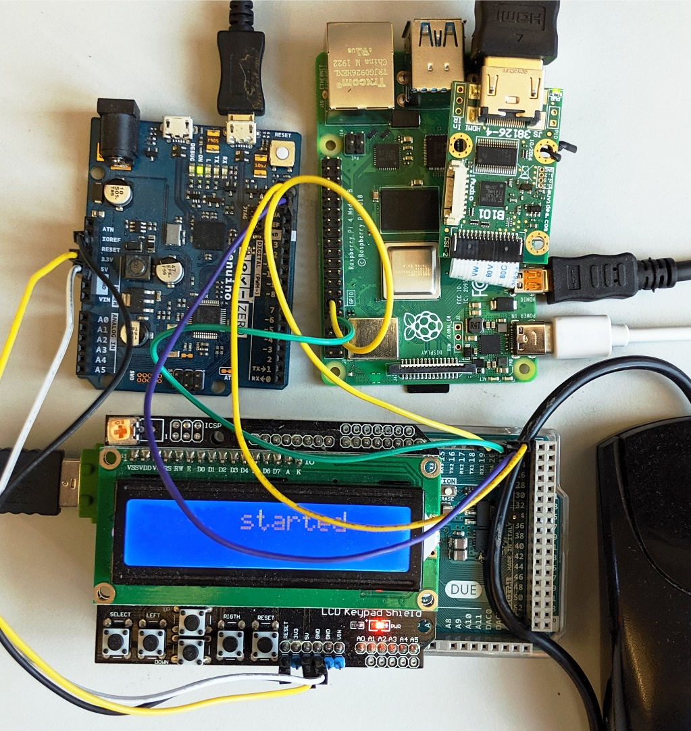

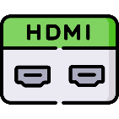

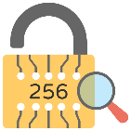



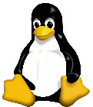

Prototype and TCB
Low TCB
Fast deployment
25.16M
20.92M
1.9K
2M
3.5K
71K
893
600K
121K
36.68M

Slide 54
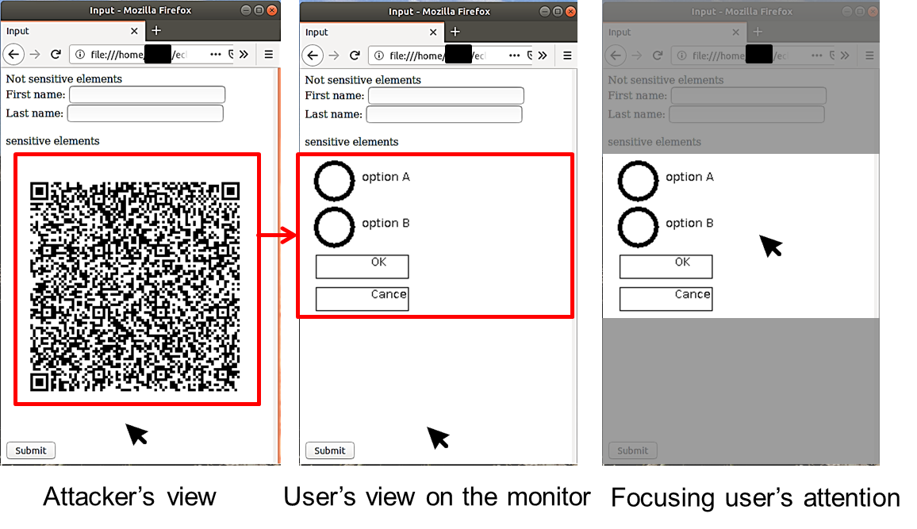

Performance
Display latency: 21.67 ms
~46 fps
Mouse latency: 250 $μs$
Keyboard latency: 170 $μs$
Pointer detection accuracy: 0.997

Slide 55
ProtectIOn $→$ProximiTEE
Remote trusted path application

Slide 56
ProtectIOn $→$ProximiTEE
Remote trusted path application
Identity of the platform

Slide 57









Motivation: Remote Attestation
Sensitive data
Enclave
A legitimate platform
A legitimate enclave
Platform PK
Report
Challenge
CPU
Verifier
Signed report

Slide 58





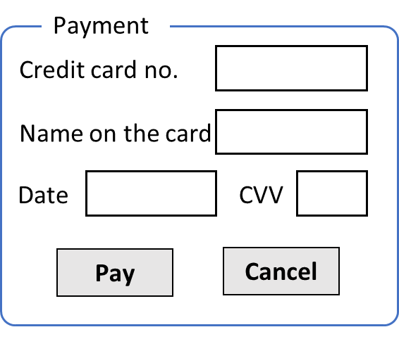

Relay Attacker
Challenge
App
Enclave
OS
Signed report
CPU
Verifier
Target platform
Relay challenge
Signed report
App
Enclave
OS
CPU
Assign secret
Attacker’s platform

Slide 59

Our Contribution: Auxiliary Device
App
Enclave
OS
CPU
ProximiKey
Verifier
Target platform
App
Enclave
OS
CPU
Attacker’s platform

Slide 60
ProximiTEE
App
Enclave
Establish secure channel
OS
CPU
ProximiKey
Verifier
Target platform
App
Enclave
OS
CPU
Attacker’s platform

Slide 61
ProximiTEE
App
Enclave
OS
CPU
ProximiKey
Target platform

Slide 62
ProximiTEE
App
Enclave
Initiate remote attestation
OS
Report + platform pk
CPU
ProximiKey
Target platform

Slide 63
ProximiTEE
App
Enclave
Secure channel
OS
CPU
ProximiKey
Target platform

Slide 64
ProximiTEE
Calculate latency
Determine proximity
App
Enclave
Challenge
OS
Response
CPU
ProximiKey
Target platform

Slide 65
ProximiTEE
Verifier
App
Enclave
OS
App
Enclave
CPU
ProximiKey
OS
Target platform
CPU
Attacker’s platform

Slide 66
ProximiTEE
Latency > threshold
Possible relay attack
App
Enclave
OS
CPU
Verifier
Target platform
App
Enclave
OS
CPU
Attacker’s platform

Slide 67



ProximiTEE
App
Enclave
Signed proximity result
OS
CPU
Verifier
Signed report
Target platform
A specific legitimate platform
App
Enclave
A legitimate enclave running on that platform
OS
CPU
Attacker’s platform

Slide 68
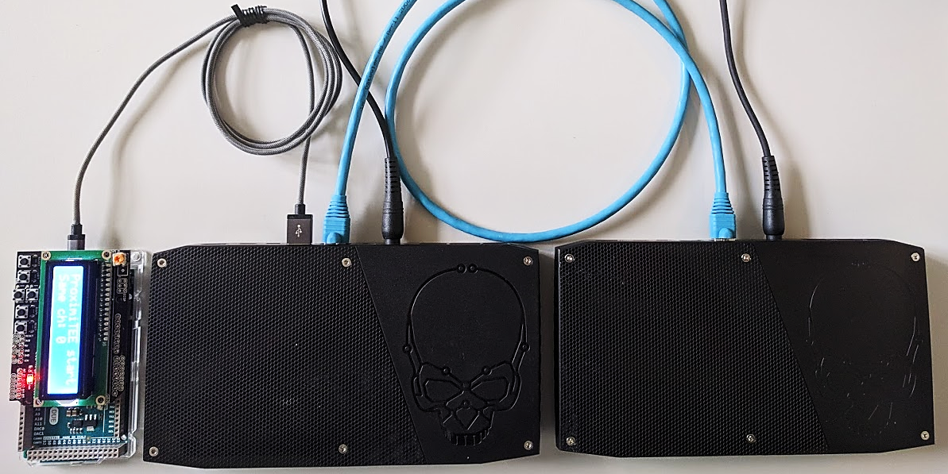
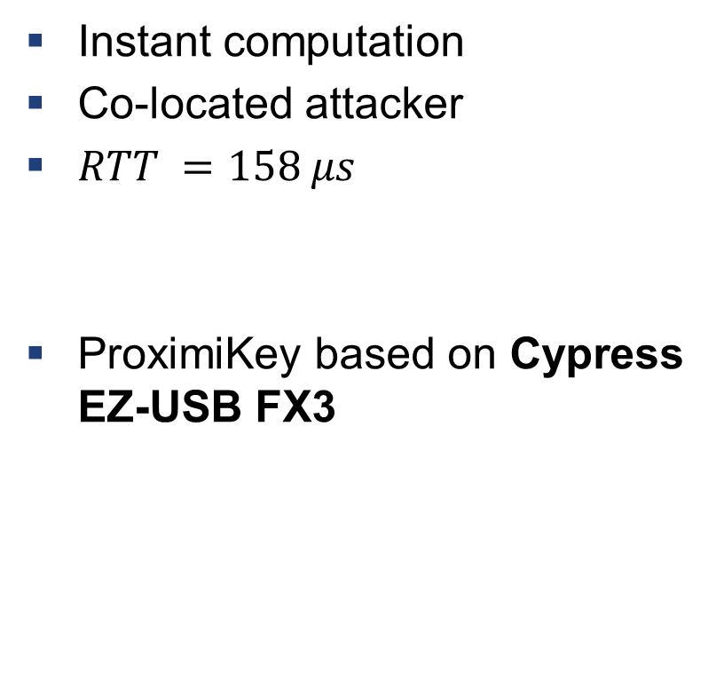
Setup: Simulating a Powerful Attacker
ProximiKey
USB 3.0 interface
1m Ethernet cable
Instant computation
Co-located attacker
$RTT =158 μs$
ProximiKey based on Cypress EZ-USB FX3
Target platform
Attacker’s platform

Slide 69
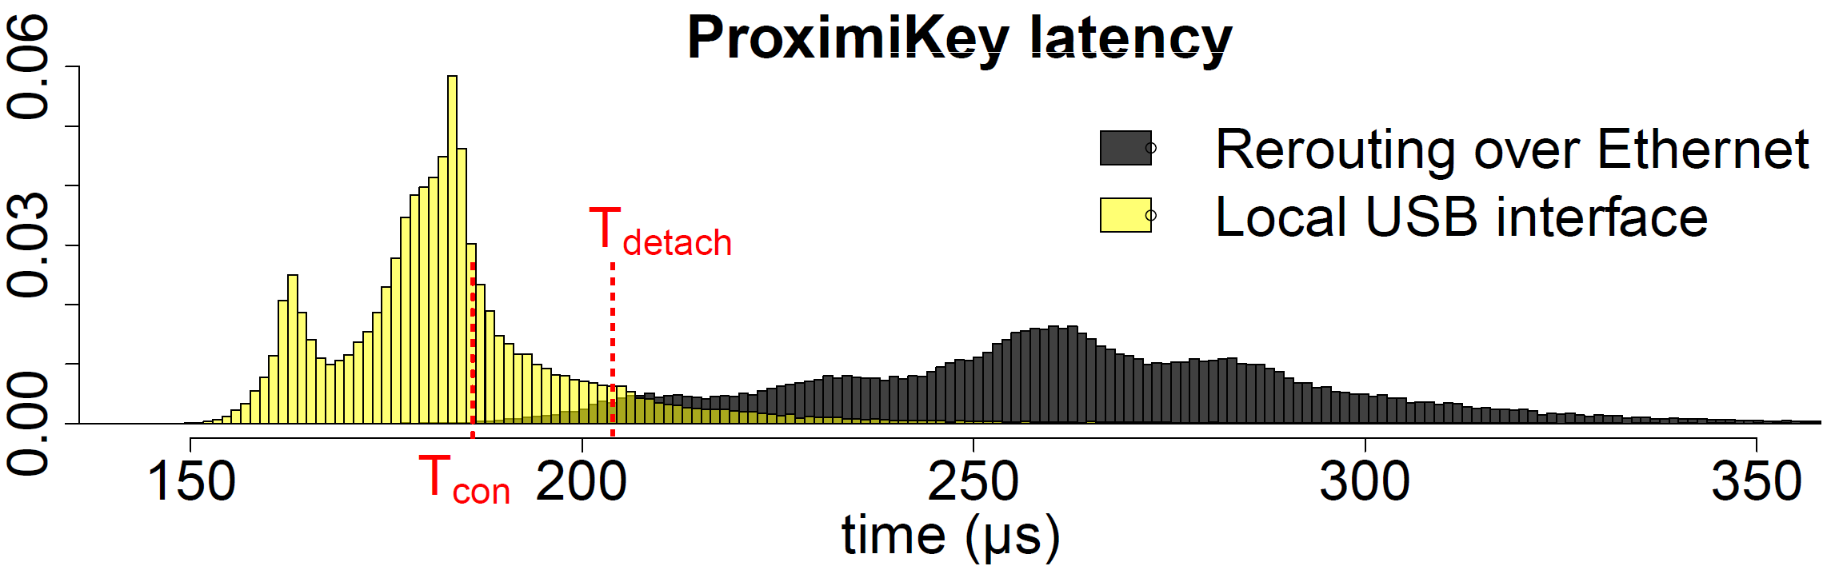
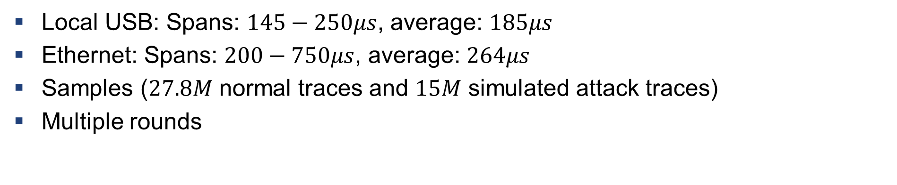
Main Experimental Result
Local USB: Spans: $145−250μs$, average: $185μs$
Ethernet: Spans: $200−750μs$, average: $264μs$
Samples ($27.8M$ normal traces and $15M$ simulated attack traces)
Multiple rounds

Slide 70
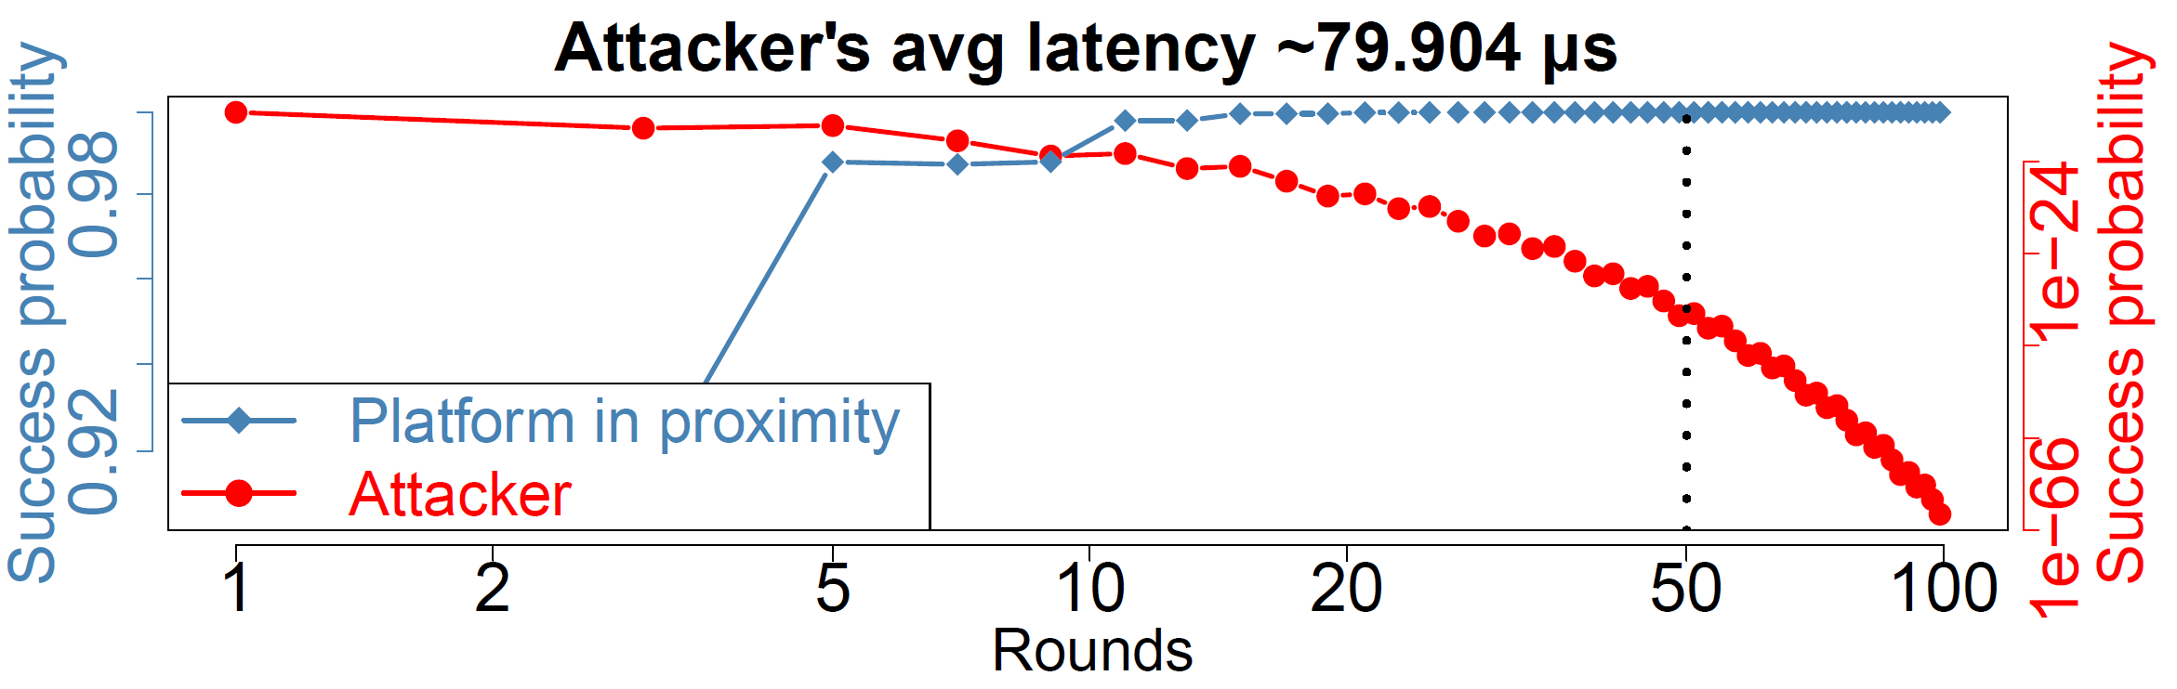
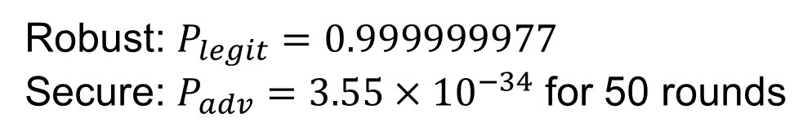
Proximity Verification Result
Robust: $P_{legit}=0.999999977$
Secure: $P_{adv}=3.55×{10}^{−34}$ for 50 rounds

Slide 71



Potential Use case: Trusted IO with Enclaves in Data Centre
I/O
I/O
User
User’s PC
Data center

Slide 72

Potential Use case: Setup of Permissioned Blockchain
Consensus node
Verifiers
Verifiers
Consensus node
Authority
Consensus node

Slide 73
Periodic Proximity Verification

Slide 74
Summary
PIE
ProtectIOn
Remote system
Remote trusted path application
ProximiTEE

Slide 75


Thank you!

Slide 76
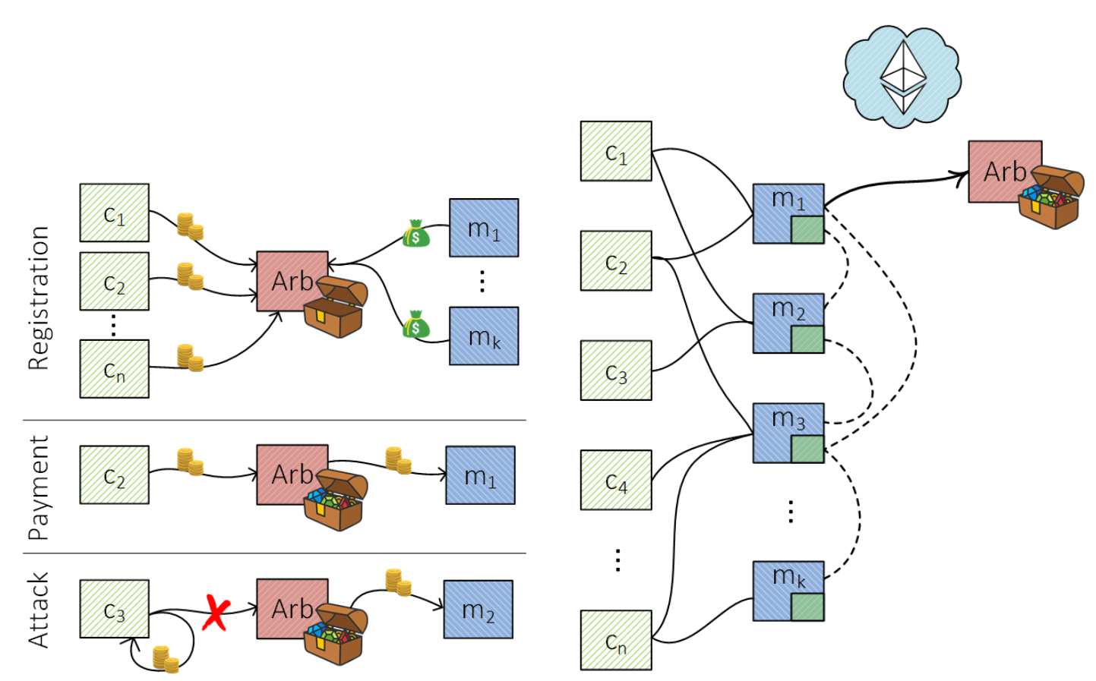
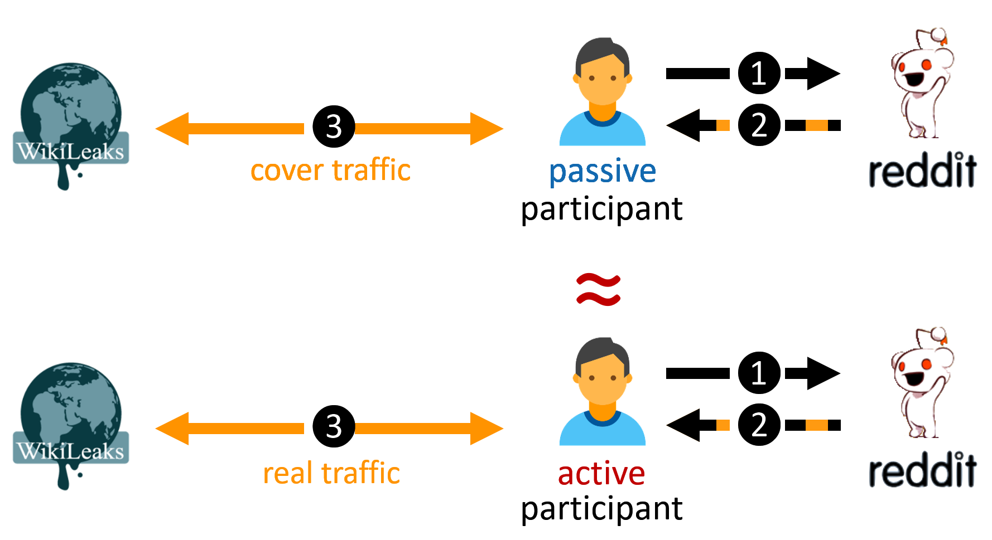
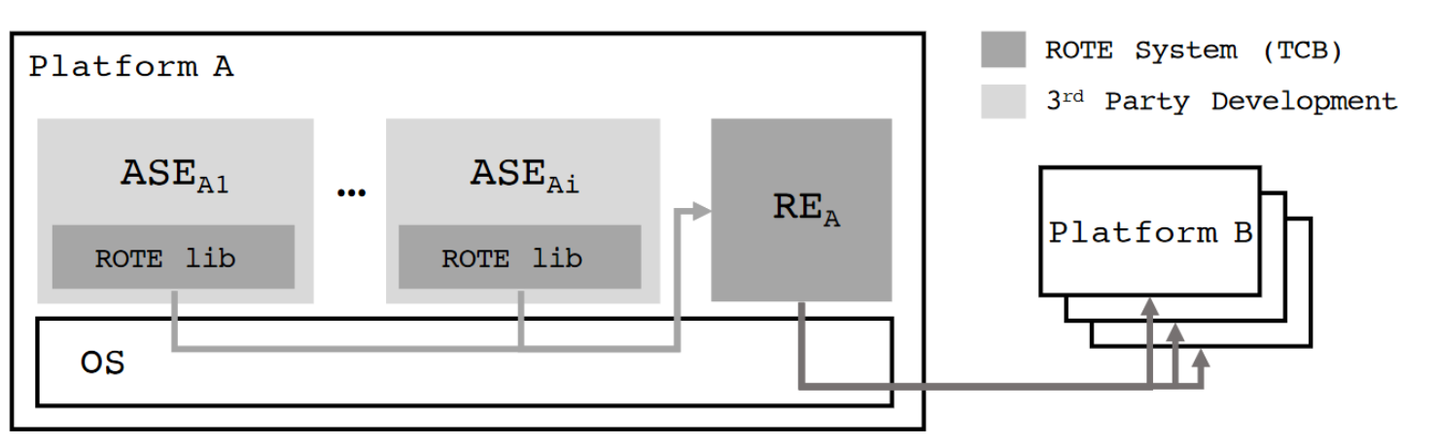
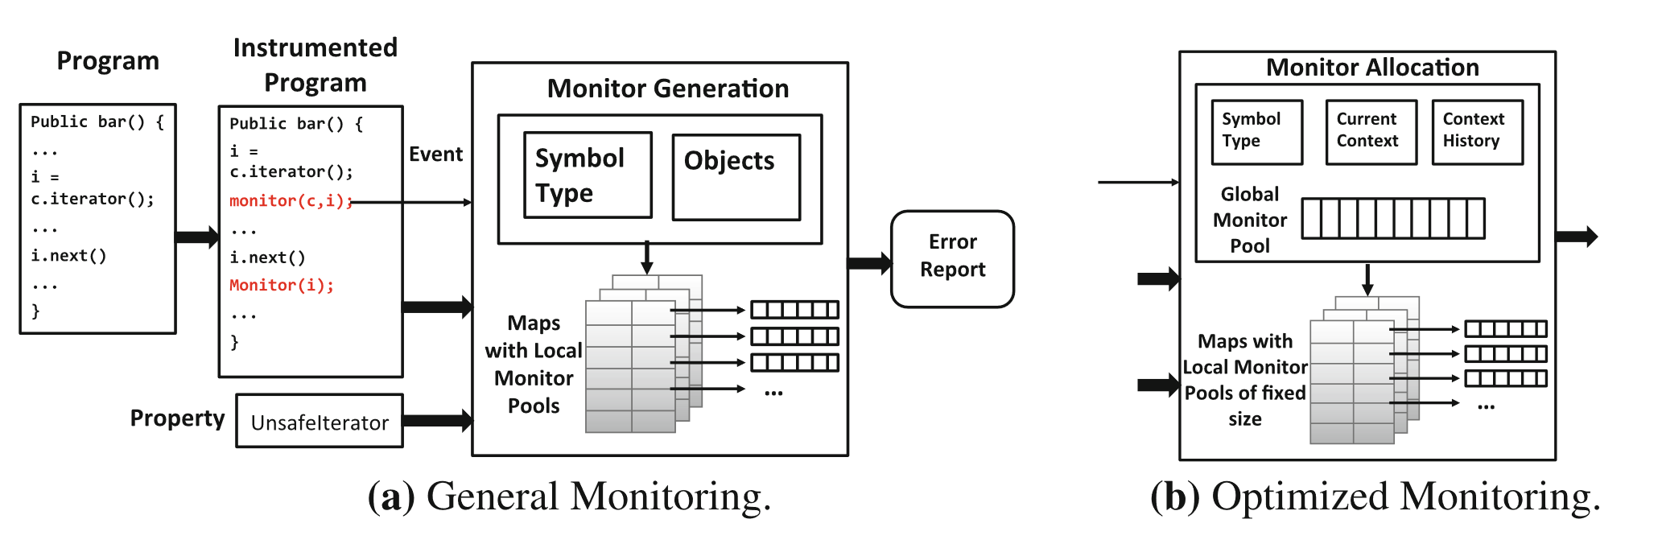
Other contributions
Fast off-chain payments
Snappy (NDSS 2020)
Anonymous communication
CoverUp (NSDI 2019)
Monitoring of type-state properties
Metis (RV 2018)
Rollback protection for SGX
ROTE (USENIX 2017)

